Slide 1
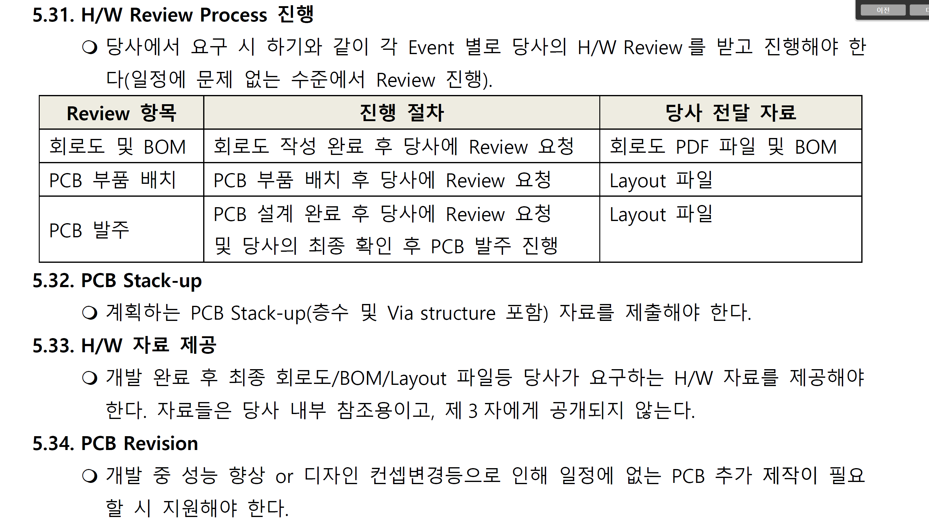
SK Broadband Soundbar STB Manufacturer Technical Requirements(Ver1.0, 2020-04-09) -> Original Version

Slide 2
SK Broadband Soundbar STB Manufacturer Technical Requirements(Ver1.0, 2020-04-09) -> English Version
5. H/W Specification
5.31. H/W Review Process
If requested by the company, the ODM vendor must receive and proceed with our H/W review for each event as follows
(review is conducted at a level without any problems in the schedule).
5.32. PCB Stack-up
The planned PCB stack-up (including the number of layers and via structures) should be submitted.
5.33. H/W data provided
After development is completed, the final circuit diagram/BOM/Layout file and other H/W data required by the company must be provided.
The materials are for our internal reference only and are not disclosed to third parties.
5.34. PCB Revision
During development, it is necessary to support when additional PCB production that is not scheduled due to performance improvement or design concept
change is required.
Review Items | Review Process | Submit Items
Schematics and BOM | After completing the schematic, ask us to review | Schematics(PDF file), BOM file
PCB Layout | After completing the PCB layout, ask us to review | PCB Layout file
PCB Order | After the PCB design is completed, request for review from us and final confirmation of our company, then place an order for PCB | PCB Layout file

